Slide 1
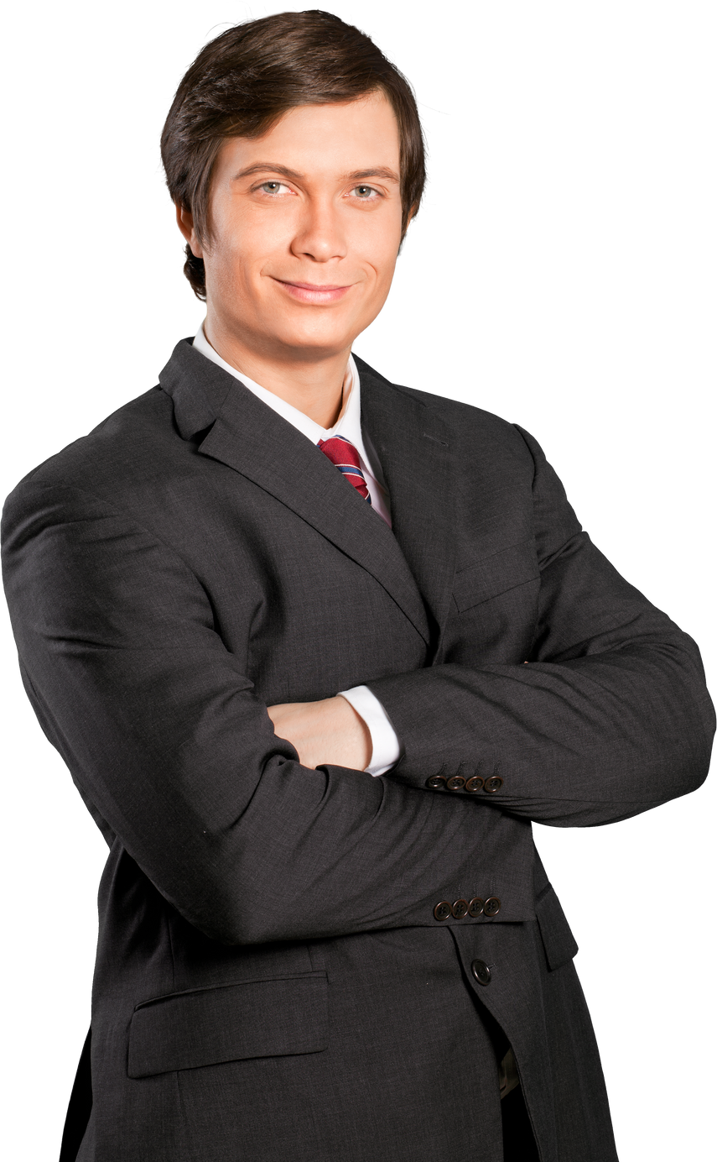
VOTE JAMES SMITH
FOR A
BRIGHTER & BETTER
FUTURE.
Election date | Feb 2024

Slide 2
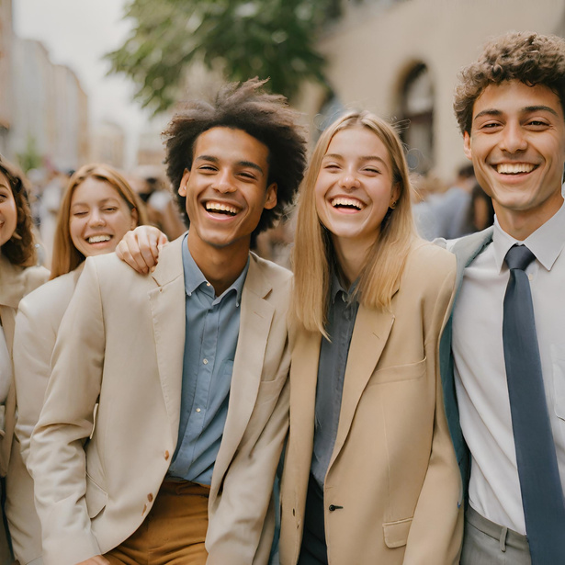

WHY US?
In 10 months we have
REDUCED ENERGY COSTS BY 20% AND CREATED MORE JOBS FOR GRADUATES.
VOTE PARTY B
4th Feb

Slide 3

COST OF LIVING
UP
AGAIN
With Party A, cost of living has gone up to 50% in the last 10 months.
Choose your government wisely.
PARTY C

Slide 4
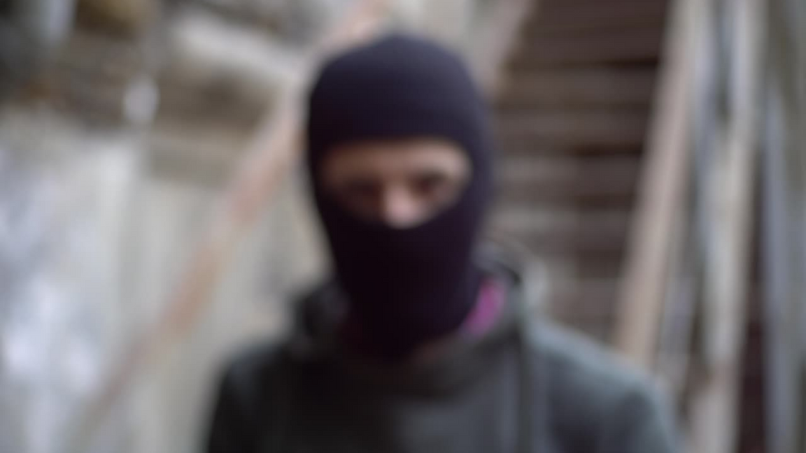
A SHIELD, NOT A THREAT
WHEN SECONDS COUNT, THE GUN RESPONDS
PARTY D
WE BELIEVE IN GUNS FOR SELF DEFENCE

Slide 5






PARTY E
WE WILL
INVEST IN HOME-GROWN, CLEAN ENERGY
SUPPORT MORE GREEN JOBS
Explore our green agenda online

Slide 6

BREAKING BARRIERS,
BUILDING FUTURES
NO ONE'S FUTURE SHOULD BE LIMITED BY THEIR BACKGROUND.
Vote Party F

Slide 7


PARTY G
2024 ELECTION
VOTE
MIKE
SMITH
Say no to false promises, yes to transparency and trust
VOTE
06

Slide 8
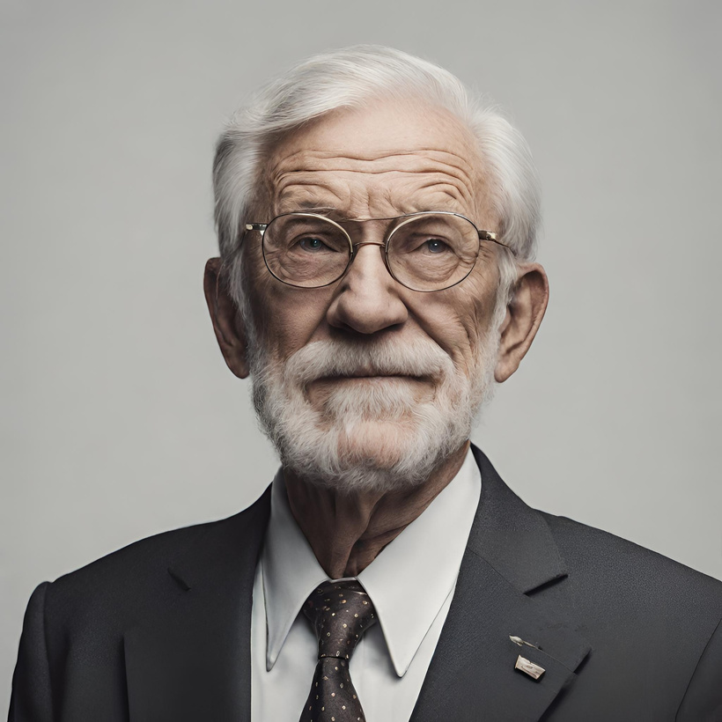
VOTE FOR THE CHANGE
George Jenkins
City Council
ELECTION DATE
FEBRUARY 25TH
PARTY H

Slide 9

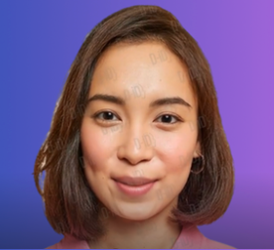
PARTY
I
“When we work together, our possibilities are endless”
ELECTIONS MARCH 2024

Slide 10

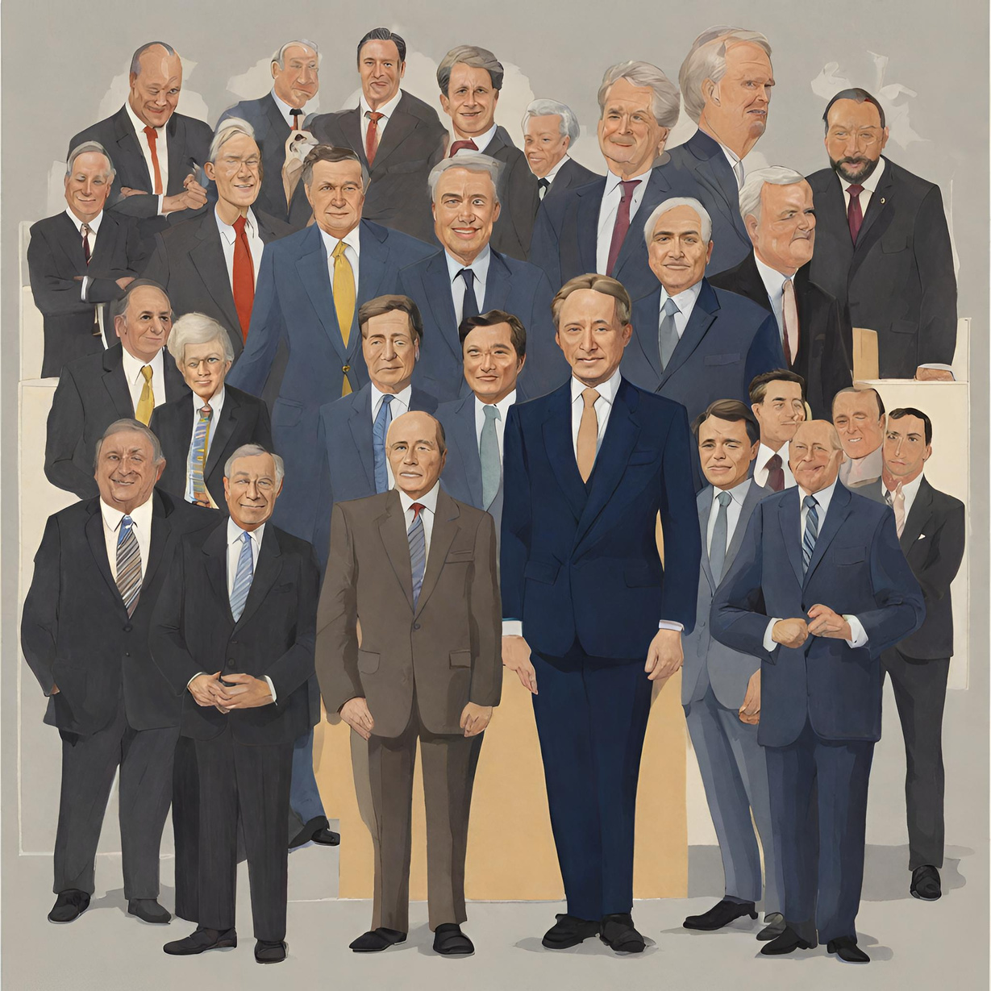

PARTY J
It’s time for a change.
Make you voice heard.
Vote to shape the future you believe in.

